Slide 1
Shiny Workshop Day 2
August 28, 2019
TEA Analytics

Slide 2
Lunch Time To-Do List
Git setup.
Connect to GitHub account.

Slide 3
TEA Shiny Server & Deployment

Slide 4
Shiny Server
It’s a web server that makes shiny apps available over the web.
PROD server
https://analyze.teainc.org
Apps are accessible from anywhere
Staging server
http://rshinydev001:3838/
Apps are available only within TEA network.
FYI:
Operating System: Linux (Ubuntu)
System Analyst: Brandon Clayton
URL is case sensitive.

Slide 5
Admin Page

Slide 6
Deployment Steps
Dev
Develop an app locally.
Staging
Place the app folder in Staging location: \\analystfs\westcoastdata\Shiny\Staging
Check your app on http://rshinydev001:3838/
If debugging is needed, do so here: http://rshinydev001:8787/
Security test.
PROD
Once all working, place the folder here: \\analystfs\westcoastdata\Shiny\Prod
Check your app on https://analyze.teainc.org/
Debug if necessary: http://rshiny001:8787

Slide 7
Demo
Deployment to Staging

Slide 8
Deployment Steps with optional steps
Dev
Develop an app locally.
Staging
Place the app folder in Staging location: \\analystfs\westcoastdata\Shiny\Staging
Check your app on http://rshinydev001:3838/
If debugging is needed, do so here: http://rshinydev001:8787/
PROD
Once all working, place the folder here: \\analystfs\westcoastdata\Shiny\Prod
Check your app on https://analyze.teainc.org/
Debug if necessary: http://rshiny001:8787
Check configurations with Brandon.
Track code changes in github.
Push local changes to remote staging branch.
Have users check the app.
Merge staging branch into master.
Check nobody is using the app.
Release with a version number.
Announcement to users.

Slide 9
App Configurations/Security
User Groups
Who are added.
One person can be in multiple groups.
Company as a group
Permission level per group
External client needs teainc.org email.
Default: All analysts, IT admin (Brandon)
Timeout
Default: 30 min
1 sec ~ indefinite.
Subfolders
Error Log -- ????
\\analystfs\westcoastdata\Shiny\Logs

Slide 10
Accessing Network Files
Certain network locations are visible from Shiny Server. (Mounting).
\\Analystfs\westcoastdata
→ /mnt/analystfs/westcoastdata
\\seaanalystfs1\Data
→ /mnt/seaanalyst1/data
Working directory is always the shiny app folder. If files are placed inside the app folder, use relative path.
Watch out if you have a path to a file in the network.
Make a copy in an available location and use a mounted path. (different path names for Dev vs PROD).
Place the data in a database.

Slide 11
Demo by Brandon

Slide 12
External Client Access
Questions to ask:
Can we get away without giving access? (We are service providers, not app provider).
Do you have to limit the access?
Are there any sensitive data or tabs to hide?
Pre-set user inputs.
Error handling
Meaningful messages.
Safe errors.
Is it vulnerable to misinterpretation?
Disclaimer and signature page.
Who’s in charge for customer support?
Support plans
When it fails, what’s the procedure for support?

Slide 13
Support Plans
Talk with Brandon.
Example

Slide 14
Known Issues

Slide 15
Behavior Issues
No access to index page unless you are analyst or admin.
Wrong address will say you don’t have permissions.
Lower case.

Slide 16
Error at Opening
At opening, you may encounter an error which goes away by refreshing the page a few times.
Cause: The linux machine need to look into \\analystfs network locations. There seems to be a glitch somewhere.
Solution:
If we like this app file locations, no solutions have been found so far.
If we don’t mind using file transfer apps, we could place app files within the server machine…

Slide 17
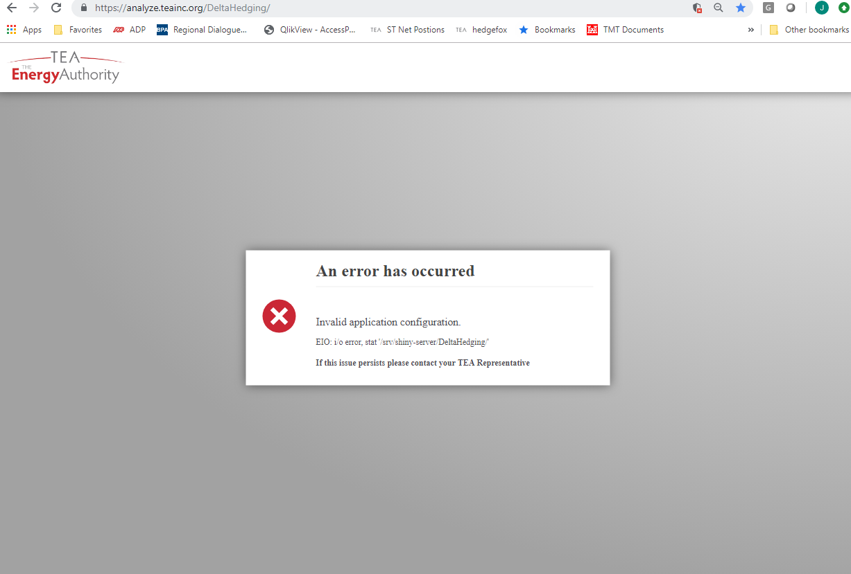

Slide 18
Version Management
We all share the same Shiny Servers.
We share the same R version and package versions on the server regardless of what you use locally.
Current R: Version 3.4.4 (2018-03-15) -- "Someone to Lean On”
We plan to update it on Feb 2020.
Agree on a version to install.
Update Staging server.
Everyone check apps.
Update PROD.
When you need to update a package for some reason, announce it to the entire group before updating it on PROD.
Potential Solution: Look into packrat: https://support.rstudio.com/hc/en-us/articles/216528108-Deploying-packrat-projects-to-Shiny-Server-Pro
Known versioning issue:
Rds files created in R version 3.5 or higher is not readable in R version 3.4 or earlier.

Slide 19
One R Studio Account to Share
We currently use an open source R Studio Server on the Shiny Server.
It’s set up so that we can debug apps in the same linux environment.
With the current settings, you may kick out someone when you login. Be aware.
Please, please quite and close everything when you are done with what you are doing.
When this becomes an issue, we’ll discuss purchasing a license for Pro Studio Server.

Slide 20


Concurrent Usages
Single thread computation:
Per App.
Not Per User.
Not Per Instance.
User A’s computation could pause B and C’s app instances.
Data loaded and cached when A opened the app could be utilized by B and C (depending on how you set it). → We’ll discuss this later.
Potential Solutions
Futures & promises.
Set up separate apps.
C
B
A

Slide 21
Database Connections

Slide 22
Database connections
Dev (Local)
No need to specify username/password in connection string. (Windows authentication used).
"Driver={SQL Server}; Server=SQLUAnalytics; Database=Ozette;“
Shiny servers (PROD or Staging)
Need to specify username/password. (Ask DBA for a generic account).
"Driver={ODBC Driver 17 for SQL Server}; Server=SQLPAnalytics; Database=Ozette; Uid=shinyuser; pwd=xxxxxxx;”
Can be used for ‘RODBC’ or ‘odbc’
Need to be updated when driver is updated.
"Driver={SQLServer}; Server=SQLPAnalytics; Database=Ozette; Uid=shinyuser; pwd=xxxxxxx;”
Can be used for ‘odbc’
Notice no space between SQL and Server.
No need to update when a driver is updated.

Slide 23
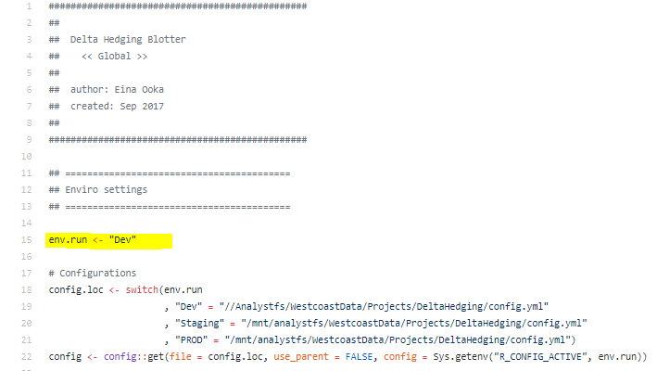
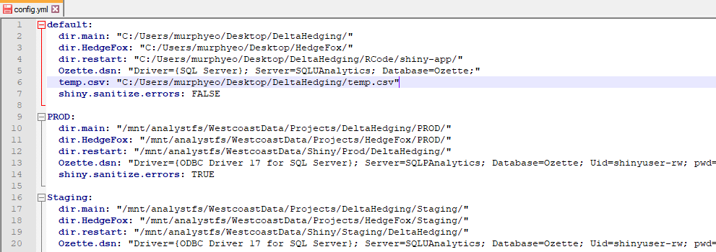
Managing connection strings

Slide 24
config
Use ‘config’ package for credential management.
Reason 1: directly typing in account info in the app code is not advised.
Reason 2: When config is stored somewhere other than in the code, deployment process is easier.
Reason 3: You can also manage file locations. (\mnt\...)
You could use a generic account of a production server for development, but recommend against it.
PROD app ↔ PROD database server
Staging app ↔ UAT database server

Slide 25

When to load data?
In global.r
Loaded once for multiple “concurrent” users.
Different load times per session, but reloading an app is generally super fast.
When global.r needs to be re-run, opening the app (before anything appears) may take a while.
Within server
Loaded once every time a session is opened.
Same load time for everyone every time.
Loading will happen at the beginning of the app, but UI will show up.
Within reactive
Loaded when needed.
Loaded when the reactive object needs an update.
A good option if data is needed only for a particular optional section of the UI.
Using reactiveValues
You decide when it’s loaded.
Useful for partial load + appending.
Users likes to know if it’s loading or broken.
Users like expected behaviors.
Users prefer initial load wait then intermittent pauses.

Slide 26
Controlling global data load
Shiny server decide to rerun global.r when:
Server is rebooted.
Server detects changes in app files.
And who knows when else.
When a new data is available, it may not necessarily know to rerun global.
→

Slide 27
Git & GitHub

Slide 28
Git & GitHub
Git is a distributed version control system that runs on your local machine. It keeps track of your files and modifications to those files in your local “repository.”
https://git-scm.com/
GitHub is a website that allows you to publish your Git repositories online and collaborate with other people.
https://github.com/
We have a private account that is not open to public.

Slide 29
Exercise
Create a new branch in ShinyWorkshop repo.
Pull this repo to your local machine.
Activate your branch.
Edit, save, stage, commit. Make sure to mention the issue number.
Push to remote repo.
Add comments on the issue page.

Slide 30
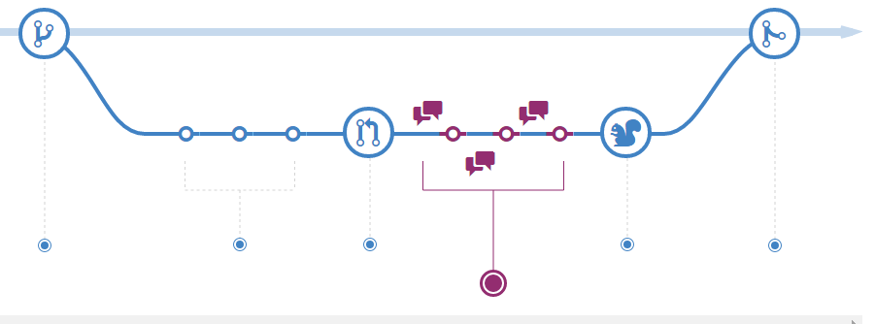
Understanding the GitHub Flow
https://guides.github.com/introduction/flow/
Create a brunch
Add commits
Open Pull Request
Discuss and review your code
Merge

Slide 31
Demo
Merge.

Slide 32
Referencing Issue Number
Any commits that references the issue number will automatically appear in the issue page so that it’s very easy to find commits that are related to particular issues.
Or vice versa, if you are looking at a history of commits, and want to know details, you can go to the actual code changes, or the issue page to find out more.

Slide 33
Debugging

Slide 34
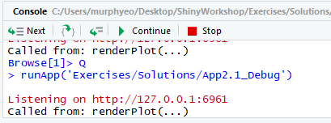
Debugging
Debug
Breakpoints
Pros: No change in your code.
Cons: works only within server.
Browser()
Pros: Like debugger but works everywhere.
Cons: Changes in code.
Print()
Add messages that are printed to the console.
Pros: You can keep it in the code for PROD.
Showcase Mode
https://shiny.rstudio.com/gallery/kmeans-example.html
runApp(…, display.mode = "showcase“)
shiny.reactlog
Detailed look at shiny reactivity.
Performance Optimization
Profvis
Find which calculation is taking time.
Activate “debugger” where you can look around while everything is suspended as is.

Slide 35
2.1 Exercise
Open App1.6_DynamicUI.
Figure out why this error flashes using browser():
Find a solution for getting rid of it.

Slide 36
Error Handling
Base R
tryCatch
Shiny
Validate(need(…, message = “”))
options(shiny.sanitize.errors = TRUE) for PROD
safeError() for controlled error messages.

Slide 37
2.2 Exercise
screenshot

Slide 38
2.2 Exercise
Rid of validate() for data imports.
Add safe error.
Set global options for Sanitize.errors.

Slide 39
Advanced Topics
Use of Module

Slide 40
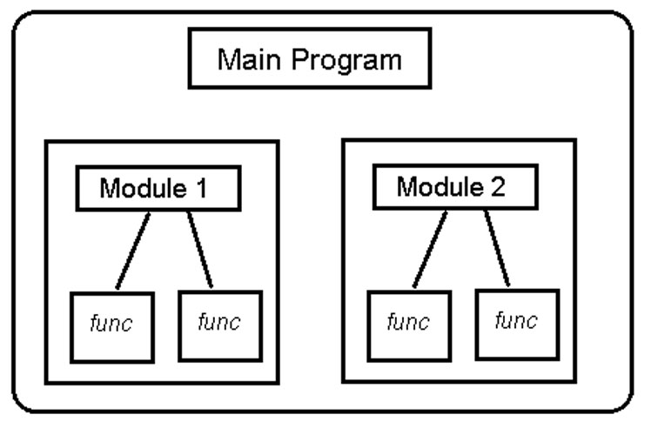
software design technique
Fact: As we develop more shiny apps, we get closer to web programmers. Adopt some of their techniques to start with.
We already talked about separation of Dev/Staging/PROD environments.
Modular programming is a software design technique that emphasizes separating the functionality of a program into independent, interchangeable modules, such that each contains everything necessary to execute only one aspect of the desired functionality.

Slide 41
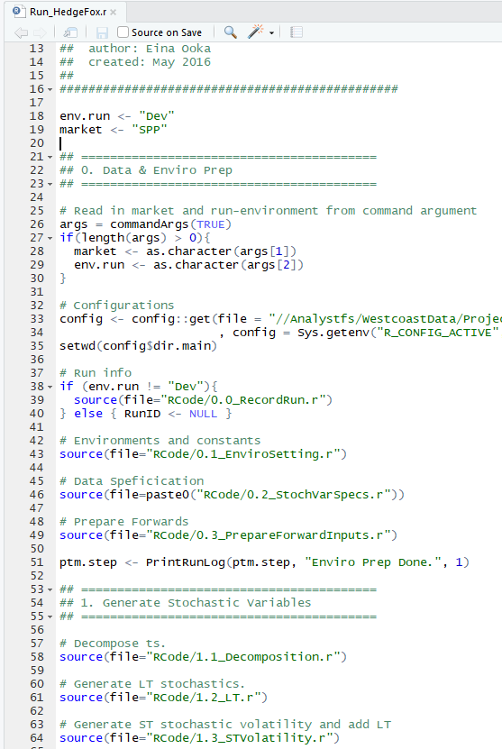
Modularization for Shiny
In R
Functions
If you repeat yourself 3 times, write a function
Or once for modularization.
Source
Technically not modular(?). But a technique to break up a program.
In Shiny
Functions
Module
Originally introduced for reducing repetitions, but more and more people are using it to break the app into modular pieces.
Bad Example: HedgeFox app
https://analyze.teainc.org/HedgeFox/PNW/
https://github.com/TEA-Analytics/HedgeFox/blob/master/RCode/shiny-app/Common/server.r#L804

Slide 42
Example
https://ijlyttle.shinyapps.io/read_delim_dygraph/
Reactive spaghetti vs reactive ravioli
https://github.com/ijlyttle/shinypod/tree/master/R
Advantages & Benefits
Like functions, Shiny modules can be called many times for various use cases. One can reuse code in the same app or in a different app. For example, many people have created debugging modules used for Shiny app development that can be used with various apps in development.
https://github.com/stanstrup/QC4Metabolomics/tree/master/Modules/Debug
Modules can help promote the standardization of apps and simpler & isolated code.
Modules also help to solve the issue of re-useability. Rather than copy and paste code, you can use modules to help manage the pieces.
No name collisions.
Disadvantages
Adds some complexity to Shiny app development for beginners and intermediate developers.
Requires that the other people know how to use your module if you plan to share it.
Could add complexity to debugging Shiny apps.
Changes the look and feel of standard Shiny apps.

Slide 43
Excercise

Slide 44
Advanced Topics
Futures & Promises

Slide 45
Futures & Promises
Solution to slowness or pause due to concurrent users or long computation.
Use multi-thread for long computations.
https://rstudio.github.io/promises/articles/shiny.html

Slide 46
Q&A

